Slide 1
Linked List
B.Sc. CSIT
3rd Semester

Slide 2
Linked List
List
Definition and Concept of LL
Insert and delete node
Linked implementation of a stack
Linked implementation of a queue
Circular linked list
Stack as a circular list
Queue as a circular list
f) Doubly linked list (insert / delete)

Slide 3
Advantages of Array
Array provides the single name for the group of variables of the same type therefore, it is easy to remember the name of all the elements of an array.
Traversing an array is a very simple process, we just need to increment the base address of the array in order to visit each element one by one.
Any element in the array can be directly/randomly accessed by using the index.
Faster execution
Very memory efficient, very little memory required.
Implementation of list using array is easier as compared to other implementations

Slide 4
Why use linked list over array?
Till now, we were using array data structure to organize the group of elements that are to be stored individually in the memory.
However, Array has several advantages and disadvantages which must be known in order to decide the data structure which will be used throughout the program.
Array contains following limitations:
The size of array must be known in advance before using it in the program.
Increasing size of the array is a time taking process.
It is almost impossible to expand the size of the array at run time.
All the elements in the array need to be contiguously stored in the memory.
Inserting or deleting an element in an array may require all of its elements to be shifted

Slide 5
Using linked list is useful because
It allocates the memory dynamically.
All the nodes of linked list are non-contiguously stored in the memory and linked together with the help of pointers.
Sizing is no longer a problem since we do not need to define its size at the time of declaration.
List grows as per the program's demand and limited to the available memory space.
i.e. The size of a linked list can grow or shrink dynamically.

Slide 6
List
?

Slide 7
A list is a sequence of related data items.
List is a data structure to store data in sequential order.
It can be an ordered collection of integer items like 3,40,75,98,100,
Eg. List of students, list of books etc.
or it can be a collection of structures like:
struct student
{
char name[20];
char class[10];
int grade;
};

Slide 8
with each structure containing a set of related data items.
Stacks and queues are special type of lists.
We call them restricted list because insertions and deletions are restricted to occur in these structures only at the ends of a list.

Slide 9
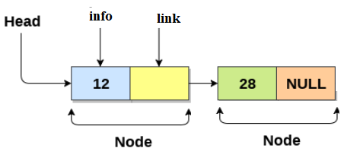
Linked List
A linked list is a collection of nodes, where each node consists of two parts: info and link

Slide 10
Linked List
info: the actual element to be stored in the list. It is also called data field.
link: one or two links that points to next and previous node in the list. It is also called next or pointer field.
The entire link list is accessed by an external pointer (say list) that points to the first node in the linked list.

Slide 11
Linked List

Slide 12
Operations on linked list
The basic operations to be performed on the linked list are as follows:
Creation: This operation is used to create a linked list.
Insertion: The insertion into a linked list can be performed at different positions. Based on the position of the new node can be inserted
  At the beginning of the linked list
  At the end of the linked list
  At the specified position in a linked list

Slide 13
Operations on linked list
The basic operations to be performed on the linked list are as follows:
Creation: This operation is used to create a linked list
Deletion: This operation is used to delete a node form linked list. A node can be deleted from:
  From the beginning of the linked list
  From the end of the linked list
  From the specified position in a linked list

Slide 14
Traversing
The list traversing is a process of going through all the nodes of the linked list from one end to the other end.
The traversing may be either forward or backward.
Searching or find: This operation is used to find an element in a linked list.
In the desired element is found then we say operation is successful otherwise unsuccessful.
Concatenation: It is the process of appending second list to the end of the first list.

Slide 15
Display
This operation is used to print the content of the list.

Slide 16
Types of Linked List
Basically we can put linked list into the following four types:
Singly linked list
doubly linked list
circular linked list
circular doubly linked list

Slide 17
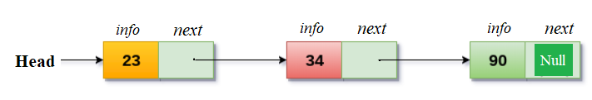
Singly linked list
A singly linked list is a dynamic data structure which may grow or shrink, and growing and shrinking depends on the operation made.
In this type of linked list each node contains two fields one is info field which is used to store the data items and another is link field that is used to point the next node in the list.
The last node has a NULL pointer.

Slide 18
Creation of Linked List
Linked list can be created as:
Struct list
{
int item;
struct list *next;
};
struct list *ptr, *start;
ptr = (node *) malloc(sizeof(node));

Slide 19
Representation of singly linked list
We can create a structure for the singly linked list the each node has two members, one is info that is used to store the data items and another is next field that store the address of next node in the list.
We can define a node as follows:
struct Node
{
int info;
struct Node *next;
};
struct Node *head;
The NULL value of the next field of the linked list indicates the last node and we define macro for NULL and set it to 0 as below:
#define NULL 0

Slide 20
Creating a Node
To create a new node, we use the malloc function to dynamically allocate memory for the new node.
After creating the node, we can store the new item in the node using a pointer to that node.
The steps required to create a node and storing an item.

Slide 21
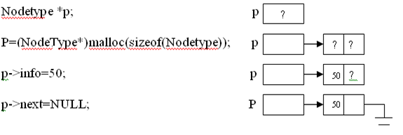
Eg 1. P is pointer to a node
struct Node *p;
p=(struct Node*)malloc(sizeof(struct Node));
p->info=50;
p->next=NULL

Slide 22
Eg.2
node *head
head = (node*) malloc (sizeof(node));
head->info=value;
head->next=NULL

Slide 23
We can use function to create a node
Nodetype *getNode()
{
NodeType *p;
p=(NodeType*)malloc(sizeof(NodeType));
return(p);
}

Slide 24
This function can be called as:
header=getnode();
header->info=value
header->next=NULL;
header
Value NULL

Slide 25
Create Empty List
void createEmpty(Struct Node *head)
{
head=NULL;
}

Slide 26
Insertion
To insert a node in a list,
  allocate required memory to a node
  assign the data in its information field
adjust the pointers to link the node at the required place

Slide 27
Algorithm to insert a node at the beginning of the singly linked list
let *head be the pointer to first node in the current list
1. Create a new node using malloc
newNode=(nodeType*)malloc(sizeof(NodeType));
2. Assign a data to the info field of newNode
newNode->info=data;
3. Set next of newNode to head
newNode->next=head
4. Set head pointer to newnode
head=NewNode;
5. end

Slide 28
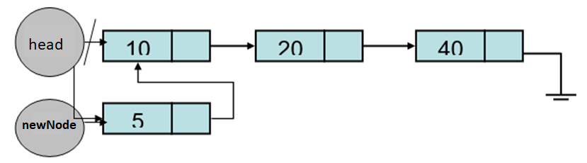

Slide 29
C function to insert a node at the beginning of SLL
void insertBeg(int item)
{
NodeType *newNode;
newNode=getNode(); //or newNode =???
newNode->info=item;
newNode->next=head;
head=newNode;
}

Slide 30
Insert a node at the end of the linked list
let *head be the pointer to the first node in the current list
1. create a new node newNode=(nodeType*)malloc(sizeof(nodeType));
2. Assign data to info newNode->info=data;
3. Set next of new node newNode->next=NULL;
4. if(head==NULL) then set head=newNode;
5.set temp=head;
6. while(temp->next!=NULL)
temp=temp->next; // temp increase
7. set temp->next=newNode;
8. End

Slide 31
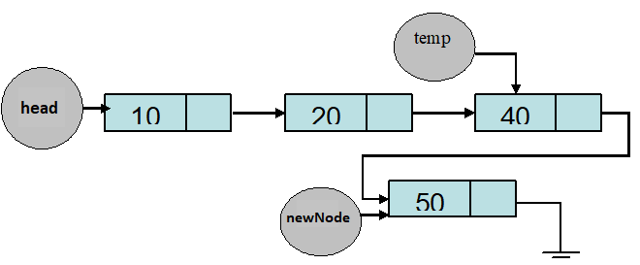

Slide 32
c function
void insertEnd(int item){
NodeType *newNode;
newNode=getNode(); // or newNode=??
newNode->info=item;
newNode->next=NULL;
if(head==NULL) {
head=newNode;
}
else{
temp=head;
while(temp->next!==NULL){
temp=temp->next;
}
temp->next=newNode;
}

Slide 33
Algorithm to insert a node at specified position
let *head be the pointer to first node in the current list
1. Create a new node newNode =(NodeType*) malloc(sizeof(NodeType));
2. Assign data in info field newNode->info=data;
3. Enter the position of the node at whcih you want to insert a new node.
postion is pos;
4. set temp=head;
5. if(head==NULL) then
insert and exit
6. for(i=1; i<pos-1; i++)
temp=temp->next;
7. set newNode->next=temp->next;
set temp->next=newNode;
8. end

Slide 34
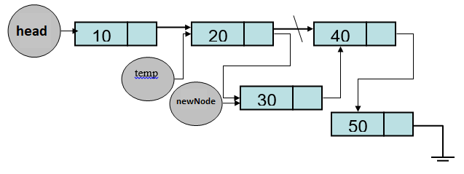

Slide 35
C function insert a node at specified position
void inspos(int item) {
NodeType *newNode;
int pos, i;
printf("enter position:");
scanf("%d", pos);
if(head==NULL){
printf("\n can't insert in pos");
}
else{
temp=head;
for(i=0; i<pos-1; i++){
temp=temp->next;
}
newNode= ???
newNode->info=item;
newNode->next=temp->next;
temp->next=newNode;
}}

Slide 36
Insert a node after the given node in SLL
  let *head be the pointer t first node
  *p be the pointer to the node
  1. Create a node using malloc
  ???
  2. Assign data to info
  ???
  3. set next of new node to next of p
  newNode->next=p->next;
  4. set next of p to newNode
  p->next =newNode
  5. end

Slide 37
C function
void insAfter(NodeType *p int item)
{
NodeType *newNode;
newNode=(NodeType*)malloc(sizeof(NodeType*));
newNode->info=data;
if(p==NULL)
{
printf("can't insert");
}
else
{
newNode->next=p->next;
p->next=newNode;
}
}

Slide 38
Delete Nodes:
a) from the beginning of the SLL
b) form the end of the SLL
c) form specifiec position in a SLL

Slide 39
Delete form the beginning
let *head be the pointer to delete the first node of SLL
1. if (head==NULL) then
printf can't delete
2. store address of first node in a temporary variable
temp=head;
3.set head to next of head
head=head->next;
4. free temp
free(temp);
5. end

Slide 40
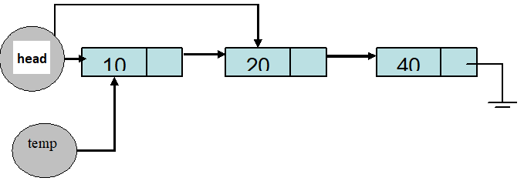

Slide 41
C function
void delFirst()
{
NodeType *temp;
if(head==NULL)
printf("empty can't delete");
else
{
temp=head;
printf("\n deleated node is:%d", head->info);
head=head->next;
free(temp);
}
}

Slide 42
Delete last node of the linked list
let *head be the pointer to first node in the current list
1. if(head==NULL)
then can't delete items
2. else if(head->next ==NULL)
set temp=head;
display deleted item head->info
then head=NULL;
free(temp);
3. else
set temp=head;
while(temp->next->next!=NULL)
set temp=temp->next;
free(temp->next);
set temp->next=NULL;
4. end

Slide 43
C function to delete the last node of the SLL
*head be the pointer to first node in the current list
void del_last()
{
NodeType *temp;
if(head==NULL)
{
printf("\n can't delete item:");
}
else if(head->next==NULL)
{
temp=head;
head=NULL;
printf("\n %d is deleted node", temp->info);
free(temp);
}

Slide 44
else
{
temp=head;
while(temp->next->next!=NULL)
{
temp=temp->next;
}
printf("\n %d is deleted item", temp->next->info);
free(temp->next);
temp->next=NULL;
}

Slide 45
An algorithm to delete a node at the specified position in a singly linked list
let *head be the pointer to first node in the current list
Read position of a node which to be deleted, let it be pos.
if head==NULL
print “can’t delete” and exit
Enter position of a node at which you want to delete a new node.
Let this position is pos.
Set temp=head
declare a pointer of a structure let it be *p
for(i=1; i<pos-1; i++)
temp=temp->next;
print deleted item is temp->next->info
Set p=temp->next;
Set temp->next =temp->next->next;
free(p);
End

Slide 46
The C function to delete a node at the specified position in a singly linked list
void delPos()
{ NodeType *temp *ptr; int pos, i;
if(head==NULL)
{
printf(“Empty list”); return;
} else
{
printf(“Enter position of a node which you wand to delete”);
scanf(“%d” , &pos);
temp=head;
for(i=1; i<pos-1; i++)
{
temp=temp->next;
}
ptr=temp->next;
printf(“Deleted item is %d”, ptr->info);
temp->next =ptr->next;
free(ptr);
}}

Slide 47
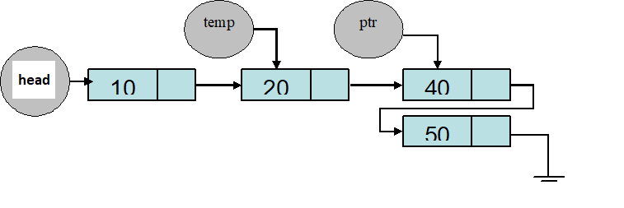

Slide 48
An algorithm to delete a node after the given node in singly linked list
let *head be the pointer to first node in the current list and *p be the pointer to the node after which we want to delete a new node.
if(p==NULL or p->next==NULL)
then print “deletion not possible and exit
2. set q=p->next
Set p->next=q->next;
free(q)
5. End

Slide 49
The C function to delete a node after the given node in singly linked list
let *p be the pointer to the node after which we want to delete a new node.
void deleteAfterNode(NodeType *p)
{
NodeType *q;
if(p==NULL || p->next==NULL )
{
printf(“Void insertion”);
exit(1);
}
else
{
q=p->next;
p->next=q->next;
free(q);
}
}

Slide 50
Searching an item in a linked list
let *head be the pointer to first node in the current list
void searchItem()
{
NodeType *temp; int key;
if(head==NULL)
{
printf(“empty list”);
exit(1);
}
else
{
printf(“Enter searched item”);
scanf('%d” ,&key);
temp=head;
while(temp!=NULL)
{
if(temp->info==key)
{
printf(“Search successful”); break;
}
temp=temp->next;
}
if(temp==NULL)
printf(“Unsuccessful search”);
} }

Slide 51
Traversing a list and displaying information stored
list traversal is the process of visiting all the nodes in the list.
Traversal is generally needed to print the items stores in each node of the list.
Algorithm for traversing and displaying
If the list is empty, print no element exist.
Else, traverse until the temp is not NULL (temp!=NULL)
While traversing print the info part each time.

Slide 52
C Code
void display()
{
nodeType *temp;
printf("\nElements of linked list are");
temp=head;
while(temp!=NULL)
{
printf("%d\t",temp->info);
temp=temp->next;
}
getch();
}

Slide 53
//Singly Linked list
#include<stdio.h>
#include<conio.h>
#include<stdlib.h>
void f_insert(); //front
void e_insert(); //end
void n_insert(); //nth position
void search();
void display();
void e_del();
void f_del();
void n_del();

Slide 54
struct list
{
int info;
struct list *next;
};
typedef struct list node;
node *ptr,*start;

Slide 55
void main()
{
int c;
ptr=(node *)malloc(sizeof(node));
do
{
clrscr();
printf("\n Menu Provided");
printf("\n 1->Insert From front\n2->Insert from end
\n3->Insert from nth position\n4->Delete from front
\n5->Delete from end \n6->Delete from nth position\n7->Traverse
\n8->Search\n9->destroy\n10->exit");
printf("\n your option");
scanf("%d",&c);
switch(c)
{
case 1:
f_insert();
break;
case 2:
e_insert();
break;

Slide 56
case 3:
n_insert();
break;
case 4:
f_del();
break;
case 5:
e_del();
break;
case 6:
n_del();
break;
case 7:
display();
break;
case 8:
search();
break;
case 9:
destroy();
break;
case 10:
exit(1);
default:
printf("\n Wrong Selection");
break;
}
}while(c!=10);
getch();
}

Slide 57
void f_insert()
{
node *item;
item=(node *)malloc(sizeof(node));
printf("\nEnter data to insert");
scanf("%d",&item->info); //palace data into info
if(start==NULL)
{
item->next=NULL; // item is a pointer
start=item; //head=item
}
else
{
item->next=start; //head->next==start
start=item; //start=item
}
}

Slide 58
void e_insert()
{
node *item,*temp;
item=(node *)malloc(sizeof(node));
printf("\nEnter data to insert:");
scanf("%d",&item->info);
item->next=NULL;
if(start==NULL)
start=item;
else
{
temp=start;
while(temp->next!=NULL)
temp=temp->next;
temp->next=item;
}
}

Slide 59
void n_insert()
{
node *item;
int n,count=1;
node *ptr,*temp;
item=(node *)malloc(sizeof(node));
printf("\nEnter the position");
scanf("%d",&n);
printf("\nenter the data to insert");
scanf("%d",&item->info);
temp=start;
while(count<n)
{
temp=temp->next;
count++;
}
item->next=temp->next;
temp->next=item;
}

Slide 60
void display()
{
node *temp;
printf("\n Elements of linked list are");
temp=start;
while(temp!=NULL)
{
printf("\t%d",temp->info);
temp=temp->next;
}
getch();
}

Slide 61
void search()
{
node *temp;
int num,count=0;
printf("\n Enter a number to search");
scanf("%d",&num);
temp=start;
do
{
count ++;
if(temp->info==num)
{
printf("\n This no. is at %d position",count);
getch();
temp=NULL;
return;
}
else
temp=temp->next;
}
while(temp!=NULL);
printf("\n This number doesnot exist in list");
getch();
}

Slide 62
void f_del()
{
node *ptr;
if(start==NULL)
{
printf("\n Empty list");
getch();
}
else if(start->next==NULL)
{
printf("\nDeleted element is %d",start->info);
getch();
free(start);
start=NULL;
}
else
{
ptr=start;
start=start->next;
printf("\n Deleted element is%d",ptr->info);
getch();
free(ptr);
}
}

Slide 63
void e_del()
{
node *ptr,*loc;
if(start==NULL)
{
printf("\nEmpty list");
getch();
}
else if(start->next==NULL)
{
printf("\nDeleted item is %d",start->info);
free(start);
start=NULL;
}
else
{
ptr=start;
while(ptr->next!=NULL)
{
loc=ptr;
ptr=ptr->next;
}
loc->next=NULL;
printf("\nDeleted element is %d",ptr->info);
getch();
free(ptr);
}
}

Slide 64
void n_del()
{
node *temp,*ptr;
int n,count=1;
if(start==NULL)
{
printf("\nEmpty list");
getch();
}
else
{
printf("\n Enter a position");
scanf("%d",&n);
ptr=start;
while(count<n)
{
count++;
temp=ptr;
ptr=ptr->next;
}
temp->next=ptr->next;
printf("\nDeleted item is %d",ptr->info);
getch();
free(ptr);
}
}

Slide 65
Implementation of Stack using Linked List
Stack is a collection of items in which addition of new items and deletion of existing items are done from only one end known as top of stack.
Since, linked list is also a list of items, concepts of stack can be implemented using linked lists instead of an array.

Slide 66
The two operations that we apply on a stack are push (inserting item on the top) and pop (deleting item at the top).
The push operation is similar to adding a new node at the beginning of the list (insertHead()).
A stack items can be accessed only through its top, and a list items can be accessed from the pointer to the first node.
Similarly, removing the first node from a linked list (deleteHead()) is similar to popping an item from a stack. In both cases, the only immediately accessible item of a collection is removed from that collection, and the next item becomes immediately accessible one.
The first node of the list is the top of the stack

Slide 67
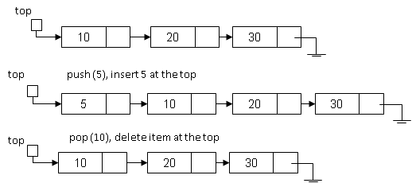

Slide 68
Linked list implementation of Stack
Push function:
let *top be the top of the stack or pointer to the first node of the list.
void push(item)
{
NodeType *nnode;
int data;
nnode=( NodeType *)malloc(sizeof(NodeType));
if(top==0)
{
nnode->info=item;
nnode->next=NULL;
top=nnode;
}
else

Slide 69
{
nnode->info=item;
nnode->next=top;
top=nnode;
} }

Slide 70
Pop function
let *top be the top of the stack or pointer to the first node of the list.
void pop()
{
NodeType *temp;
if(top==0)
{
printf("Stack contain no elements:\n");
return;
}
else
{
temp=top;
top=top->next;
printf("\ndeleted item is %d\t", temp->info);
free(temp);
} }

Slide 71
H/W
WAP Complete program Linked list implementation of Stack.

Slide 72
Implementing Queue using Linked List
A queue is a special type of list that allows insertion at one end, called the rear of queue, and deletion at other end, called the front of queue.
To implement a queue in a linked list, we make the first node of the list as the front and the last node as the rear.
So, we will use two pointer variables – front and rear. ‘front’ will point to the beginning of the list (like start) while ‘rear’ will point to the last node of the list .
Initially, when the queue is empty, both rear and front will be NULL.

Slide 73
To enqueue a new item, we insert it after the rear node and update rear to point to new node.
This function will work similarly as insertTail(), because both are the process to add new item after the last node. In the case of Queue, we insert a new item after the node pointed by ‘rear’.
To dequeue an item, we remove the front node and update front to point to the next node. This function will work similarly as deleteHead() of general list or pop() operation of stack.

Slide 74
Linked list implementation of queue
In the linked queue, there are two pointers maintained in the memory i.e. front pointer and rear pointer.
The front pointer contains the address of the starting element of the queue while the rear pointer contains the address of the last element of the queue.
let *rear and *front are pointers to the first node of the list initially and insertion of node in linked list done at the rear part and deletion of node from the linked list done from front part.

Slide 75
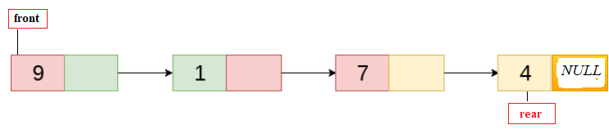

Slide 76
Insert function
void enqueue(int item)
{
struct node *newNode;
newNode=( struct node*)malloc(sizeof(struct node));
if(rear==0)
{
newNode->info=item;
newNode->next=NULL;
rear=front=newNode;
}

Slide 77
else
{
newNode->info=item;
newNode->next=NULL;
rear->next=newNode;
rear=newNode;
}
}

Slide 78
Delete function
let *rear and *front are pointers to the first node of the list initially and insertion of node in linked list done at the rear part and deletion of node from the linked list done from front part.
void dequeue() {
struct node *temp;
if(front==0){
printf("Queue contain no elements:\n");
}
else if(front->next==NULL) {
temp=front;
rear=front=NULL;
printf("\nDeleted item is %d\n", temp->info);
free(temp);
}

Slide 79
else
{
temp=front;
front=front->next;
printf("\n Deleted item is %d\n",temp->info);
free(temp);
} }

Slide 80
H/w
Write a Complete C program for linked list implementation of queue:

Slide 81
Advantages of Linked List over Contiguous List
A Linked list is a dynamic data structure. Therefore, can grow or shrink in size during the execution of a program.
Another advantage is that a linked list doesn’t waste memory space.
The third and the more important advantage is that the linked lists provide flexibility in allowing the items to be rearranged efficiently.

Slide 82
Array Vs List
The number of elements of an array is fixed when the array is created. In contrast, the number of elements in a list can be varied by adding or removing elements.
The index of a component of an array is unique and fixed.
In contrast, the position of an element in a list can vary over time.
All components of an array can be accessed easily in constant time, but there is no statement that the same is true for the elements of a list

Slide 83
Limitations of Linked Lists
Whenever we deal with a fixed length list, it would be better to use an array rather than a linked list.
Linked list will use more storage than an array with the same number of items. This is because each item has an additional link field.
To visit a particular list we have to start right from the starting node

Slide 84
Circular Linked list
In a circular Singly linked list, the last node of the list contains a pointer to the first node of the list.
Circular linked lists can be used to help the traverse the same list again and again if needed.
A circular list is very similar to the linear list where in the circular list the pointer of the last node points not NULL but the first node.

Slide 85
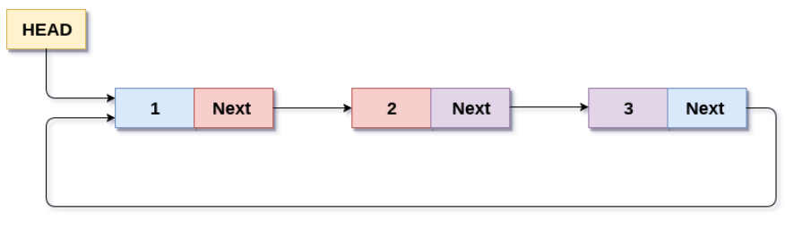
Circular Singly Linked List

Slide 86
Insert item at beginning of CLL
void ins_beg()
{
int item;
newNode = (struct node *)malloc(sizeof(struct node));
printf("\nEnter the node data?");
scanf("%d",&item);
newNode ->info = item;
if(head == NULL)
{
head = newNode;
newNode -> next = head;
}

Slide 87
else
{
temp = head;
while(temp->next != head){
temp = temp->next;
}
newNode->next = head;
temp -> next = newNode;
head = newNode;
}
} }

Slide 88
Insertion at the end
void lastinsert()
{
int item;
newNode = (struct node *)malloc(sizeof(struct node));
printf("\nEnter Data?");
scanf("%d",&item);
ptr->data = item;
if(head == NULL)
{
head = newNode;
newNode -> next = head;
}

Slide 89
else
{
temp = head;
while(temp -> next != head)
{
temp = temp -> next;
}
temp -> next = newNode;
newNode -> next = head;
}

Slide 90
Delete from the begining
void beg_del()
{
if(head == NULL)
{
printf("\n There is no item in CSSL");
}
else if(head->next == head)
{
printf(“\n deleted item is %d”, head->info);
head = NULL;
free(head);
}

Slide 91
else
{ temp = head;
while(temp -> next != head){
ptr = ptr -> next;
}
temp->next = head->next;
printf(“\n Deleted item is %d”, head->info);
head = head->next;
}
}

Slide 92
In a circular linked list there are two methods to know if a node is the first node or not.
Either a external pointer, list, points the first node or
A header node is placed as the first node of the circular list.
The header node can be separated from the others by either having a sentinel value as the info part or having a dedicated flag variable to specify if the node is a header node or not.

Slide 93
Algorithms to insert a node in a circular linked list
Algorithm to insert a node at the beginning of a circular linked list:
1. Create a new node as
newnode=(NodeType*)malloc(sizeof(NodeType));
2. if start==NULL then
newnode->info=item
newnode->next=newnode
start=newnode
set last newnode
3. else
set newnode->info=item
newnode->next=start
start=newnode
  set last->next=newnode
end else
4. End

Slide 94
Algorithm to insert a node at the end of a circular linked list
1. Create a new node as
newnode=(NodeType*)malloc(sizeof(NodeType));
2. if start==NULL then
set newnode->info=item
newnode->next=newnode
set start=newnode
set last newnode end if
3. else
set newnode->info=item
set last->next=newnode
set last=newnode
set last->next=start end else
4. End

Slide 95
C function to insert a node at the beginning of a circular linked list
void InsertAtBeg(int Item)
{
NodeType *newnode; newnode=(NodeType*)malloc(sizeof(NodeType));
if(start==NULL)
{
newnode->info=item;
newnode->next=newnode;
start=newnode;
last newnode;
}
else
{
newnode->info=item
newnode->next=start
start=newnode
last->next=newnode
}
}

Slide 96
C function to insert a node at the end of a circular linked list
void InsertAtEnd(int Item)
{
NodeType *newnode; newnode=(NodeType*)malloc(sizeof(NodeType));
if(start==NULL)
{
newnode->info=item;
newnode->next=newnode;
start=newnode;
last newnode;
}
else
{
newnode->info=item;
last->next=newnode;
last=newnode;
last->next=start;
}
}

Slide 97
Algorithms to delete a node from a circular linked list
Algorithm to delete a node from the beginning of a circular linked list
1. if start==NULL then
“empty list” and exit
2. else
set temp=start
set start=start->next
print “the deleted element=temp->info”
set last->next=start;
free(temp) end else
3. End

Slide 98
Algorithm to delete a node from the end of a circular linked list
1. if start==NULL then
“empty list” and exit
2. else
if start==last
set temp=start
print deleted element=temp->info
free(temp)
start=last=NULL
3. else
set temp=start
while( temp->next!=last)
set temp=temp->next end while
set hold=temp->next
set last=temp
set last->next=start
print the deleted element=hold->info
free(hold) end else
4. End

Slide 99
C function to delete a node from the beginning of a circular linked list
void DeleteFirst()
{
if(start==NULL)
{
printf(“Empty list”);
exit(1);
}
else
{
temp=start;
start=start->next;
printf(“ the deleted element=%d”, temp->info);
last->next=start;
free(temp)
} }

Slide 100
C function to delete a node from the end of a circular linked list
void DeleteLast()
{
if(start==NULL)
{
printf(“Empty list”);
exit(1);
}
else if(start==last) //for only one node
{
temp=start;
printf(“deleted element=%d”, temp->info);
free(temp);
start=last=NULL;
}
else
{
temp=start;
while( temp->next!=last)
temp=temp->next;
hold=temp->next;
last=temp;
last->next=start;
printf(“the deleted element=%d”, hold->info);
free(hold);
} }

Slide 101
Stack as a circular List
To implement a stack in a circular linked list,
let pstack be a pointer to the last node of a circular list.
Actually there is no any end of a list but for convention let us assume that the first node(rightmost node of a list) is the top of the stack.
  An empty stack is represented by a null list.
  The structure for the circular linked list implementation of stack is:
  struct node
  {
int info;
struct node *next;
};
typedef struct node NodeType;
NodeType *pstack=NULL;

Slide 102
C function to check whether the list is empty or not as follows
int IsEmpty()
{
if(pstack==NULL)
return(1);
else
return(0);
}

Slide 103
PUSH function
void PUSH(int item)
{
NodeType newnode;
newnode=(NodeType*)malloc(sizeof(NodeType));
newnode->info=item;
if(pstack==NULL)
{
pstack=newnode;
pstack->next=pstack;
}
else
{
newnode->next=pstack->next;
pstack->next=newnode;
} }

Slide 104
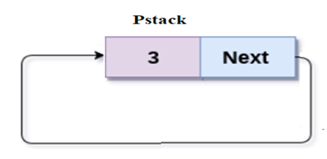
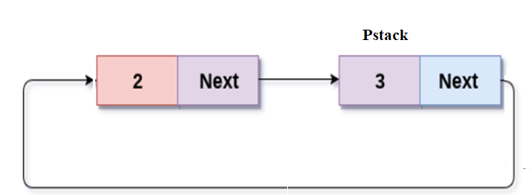
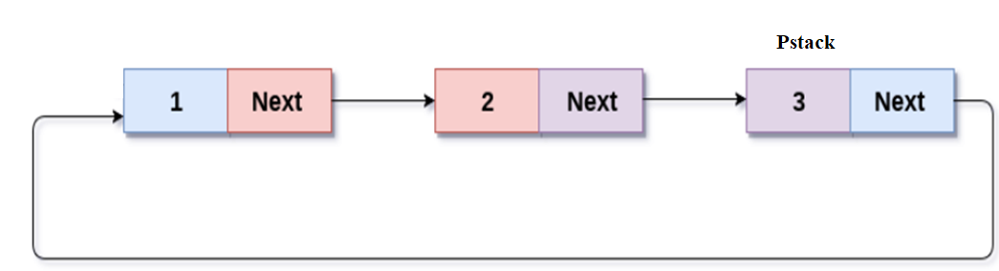
Three at the beginning
Insert 2
Insert 1

Slide 105
POP function
void POP(){
NodeType *temp;
if(pstack==NULL) {
printf(“Stack underflow\n');
exit(1);
}
else if(pstack->next==pstack){
printf(“poped item=%d”, pstack->info);
pstack=NULL;
}
else {
temp=pstack;
pstack->next=temp->next;
printf(“poped item=%d”, temp->info);
free(temp);
}
}

Slide 106
Queue as a circular List
It is easier to represent a queue as a circular list than as a linear list.
As a linear list a queue is specified by two pointers, one to the front of the list and the other to its rear.
However, by using a circular list, a queue may be specified by a single pointer q to that list.
node(q) is the rear of the queue and the following node is its front.

Slide 107
Insertion function:
void insert(int item)
{
NodeType *nnode;
nnode=( NodeType *)malloc(sizeof(NodeType));
nnode->info=item;
if(pq==NULL)
pq=nnode;
else
{
nnode->next=pq->next;
pq->next=nnode;
pq=nnode;
} }

Slide 108
Deletion function
void delet(int item){
NodeType *temp;
if(pq==NULL){
printf(“void deletion\n”); exit(1);
}
else if(pq->next==pq){
printf(“poped item=%d”, pq->info);
pq=NULL;
}
else {
temp=pq->next;
pq->next=temp->next;
printf(“poped item=%d”, temp->info); free(temp);
} }

Slide 109
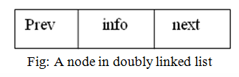
Doubly Linked List
A linked list in which all nodes are linked together by multiple number of links i.e. each node contains three fields (two pointer fields and one data field) rather than two fields is called doubly linked list.
It provides bidirectional traversal.

Slide 110
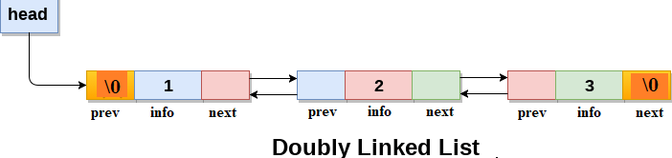

Slide 111
C representation of doubly linked list:
struct node
{
int info;
struct node *prev;
struct node *next;
};
typedef struct node *temp,* newNode *head=NULL;

Slide 112
Algorithms to insert a node in a doubly linked list
Algorithm to insert a node at the beginning of a doubly linked list:
1. Allocate memory for the new node as,
newnode=(NodeType*)malloc(sizeof(NodeType))
2. Assign value to info field of a new node
set newnode->info=item
3. set newnode->prev=newnode->next=NULL
4. set newnode->next=head
5. set head->prev=newnode
6. set head=newnode
7. End

Slide 113
C function to insert a node at the beginning of a DLL
void Ins_Beg(int Item){
NodeType *newnode;
newNode=(struct node*)malloc(sizeof(struct node)); newNode->info=item;
newNode->prev=newNode->next=NULL;
newNode->next=head;
head->prev=newNode;
head=newNode;
}

Slide 114
Algorithm to insert a node at the end of a doubly linked list
1. Allocate memory for the new node as,
newNode=(struct node*)malloc(sizeof(struct node))
2. Assign value to info field of a new node
set newNode->info=item
3. set newNode->next=NULL
4. if head==NULL
set newNode->prev=NULL;
set head=newNode;
5. if head!=NULL
set temp=head
while(temp->next!=NULL)
temp=temp->next;
end while
set temp->next=newNode;
set newNode->prev=temp
6. End

Slide 115
Algorithm to delete a node from beginning of a DLL
1. if head==NULL then
print “empty list” and exit
2. else
set temp=head
set head=head->next
set head->prev=NULL;
free(temp)
3. End

Slide 116
Algorithm to delete a node from end of a doubly linked list
1. if head==NULL then
print “empty list” and exit
2. else if(head->next==NULL)
then
set temp=head
set head=NULL
free(temp)
3. else
set temp=head;
while(temp->next->next !=NULL)
temp=temp->next
end while
set hold=temp->next
set temp->next=NULL
free(hold)
4. End

Slide 117
Nth position insertion and deletion???
void insertion_specified() {
struct node *ptr,*temp;
int item,loc,i;
newNode = (struct node *)malloc(sizeof(struct node));
temp=head;
printf("Enter the location");
scanf("%d",&loc);
for(i=0;i<loc;i++)
{
temp = temp->next;
if(temp == NULL)
{
printf("\n can’t insert”);
}
}

Slide 118
else {
printf("Enter value");
scanf("%d",&item);
newNode->info = item;
newNode->next = temp->next;
newNode -> prev = temp;
temp->next = newNode;
temp->next->prev=newNode;
} }

Slide 119
Delete
void deletion_specified()
{
struct node *ptr, *temp;
int val;
printf("\n Enter the data after which the node is to be deleted : ");
scanf("%d", &val);
temp = head;
while(temp -> info!= val)
temp = temp -> next;
if(temp -> next == NULL) {
printf("\n Can't delete");
}
else if(temp -> next -> next == NULL) {
ptr ->next = NULL;
}

Slide 120
else {
ptr = temp -> next;
temp -> next = ptr -> next;
ptr -> next -> prev = temp;
free(ptr);
printf("\n node deleted");
} }

Slide 121
void display(){
struct node *temp;
printf("\n values::");
temp = head;
while(temp!= NULL)
{
printf("%d\n", temp->info);
temp=temp->next;
} }

Slide 122
Circular Doubly Linked List
A circular doubly linked list is one which has the successor and predecessor pointer in circular manner.
It is a doubly linked list where the next link of last node points to the first node and previous link of first node points to last node of the list.
The main objective of considering circular doubly linked list is to simplify the insertion and deletion operations performed on doubly linked list.

Slide 123
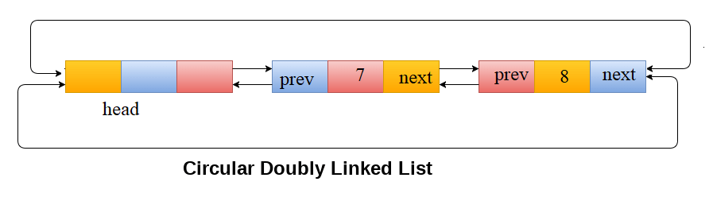

Slide 124
C representation of doubly circular linked list
struct node
{
int info;
struct node *prev; struct node *next;
};
typedef struct node NodeType;
NodeType *head=NULL:

Slide 125
Algorithm to insert a node at the beginning of a circular doubly linked list
1. Allocate memory for the new node as,
newnode=(NodeType*)malloc(sizeof(NodeType))
2. Assign value to info field of a new node
set newnode->info=item
3. set temp=head->next
4. set head->next=newnode
5. set newnode->prev=head
6. set newnode->next=temp
7. set temp->prev=newnode
8. End

Slide 126
Algorithm to insert a node at the beginning of a circular doubly linked list
1. Allocate memory for the new node as,
newnode=(NodeType*)malloc(sizeof(NodeType))
2. Assign value to info field of a new node
set newnode->info=item
3. set temp=head->next
4. set head->next=newnode
5. set newnode->prev=head
6. set newnode->next=temp
7. set temp->prev=newnode
8. End

Slide 127
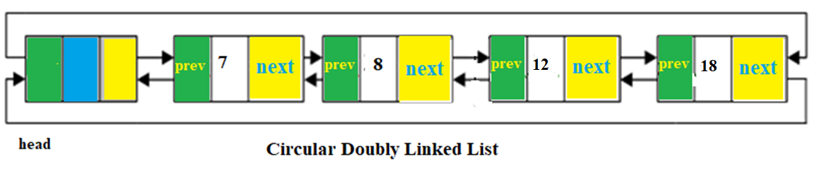
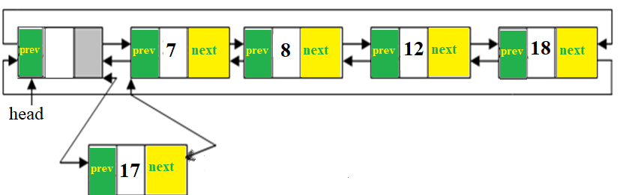

Slide 128
Algorithm to insert a node at the end of a circular doubly linked list
1. Allocate memory for the new node as,
newnode=(NodeType*)malloc(sizeof(NodeType))
2. Assign value to info field of a new node
set newnode->info=item
3. set temp=head->prev
4. set temp->next=newnode
5. set newnode->prev=temp
6. set newnode->next=head
7. set head->prev=newnode
8. End

Slide 129
Algorithm to insert a node at the end of a circular doubly linked list
1. Allocate memory for the new node as,
newnode=(NodeType*)malloc(sizeof(NodeType))
2. Assign value to info field of a new node
set newnode->info=item
3. set temp=head->prev
4. set temp->next=newnode
5. set newnode->prev=temp
6. set newnode->next=head
7. set head->prev=newnode
8. End

Slide 130
Algorithm to delete a node from the beginning of a circular doubly linked list
if head->next==NULL then
print “empty list” and exit
2. else
set temp=head->next;
set head->next=temp->next
set temp->next=head
free(temp)
3. End

Slide 131
Algorithm to delete a node from the end of a circular doubly linked list
if head->next==NULL then
print “empty list” and exit
2. else
set temp=head->prev;
set head->left=temp->left
free(temp)
3. End

